Slide 1
Create Videos using PowerPoint

Slide 2
Rhonda Bauerlein http://bit.ly/rhondabee

Slide 3
Why use video?
  Effective for challenging concepts - students can replay
  Richer than text alone
  Helpful for poor readers
  Humanize your courses to improve success

Slide 4
Uses
Introductions
Weekly overview
Lecture
Demonstration
Flip the classroom

Slide 5
Advantages
You already know PowerPoint
Don’t have to record the whole lecture at once
You can change the narration of just one slide
You can reorder slides

Slide 6
Basic Steps
Record narration in an existing PowerPoint presentation
Export as a video file
Upload video to 3C Media using the Canvas App
Get video captioned
Embed video into Canvas

Slide 7
Before you start
You’ll need a microphone or webcam
  Sennheiser PC8 Headset
  Logitech HD Pro Webcam C920
Make sure correct microphone/webcam is the default
(Control Panel > Sound > Recording)
Write a script first or wing it
  Use PowerPoint notes
Notes:
I recommend using a wired USB headset rather than Bluetooth or other wireless because it is more reliable. Bluetooth is prone to interference, and often, just when you need it most, the battery will need to be recharged.
I have a Sennheiser PC8 headset that has very good audio recording quality. It costs about $35. The webcam I recommend is the Logitech HD Pro Webcam C920 for about $50. It has good audio quality, but not as good as the Sennheiser PC8.
Before recording, make sure you check to make sure the correct microphone or webcam is set up correctly. To do this, go to the Control Panel and find Sound, then click the Recording tab.

Slide 8
Demo
Record the slide show
(Slide Show > Record Slide Show)
Turn the presentation into a video
(File > Export)

Slide 9
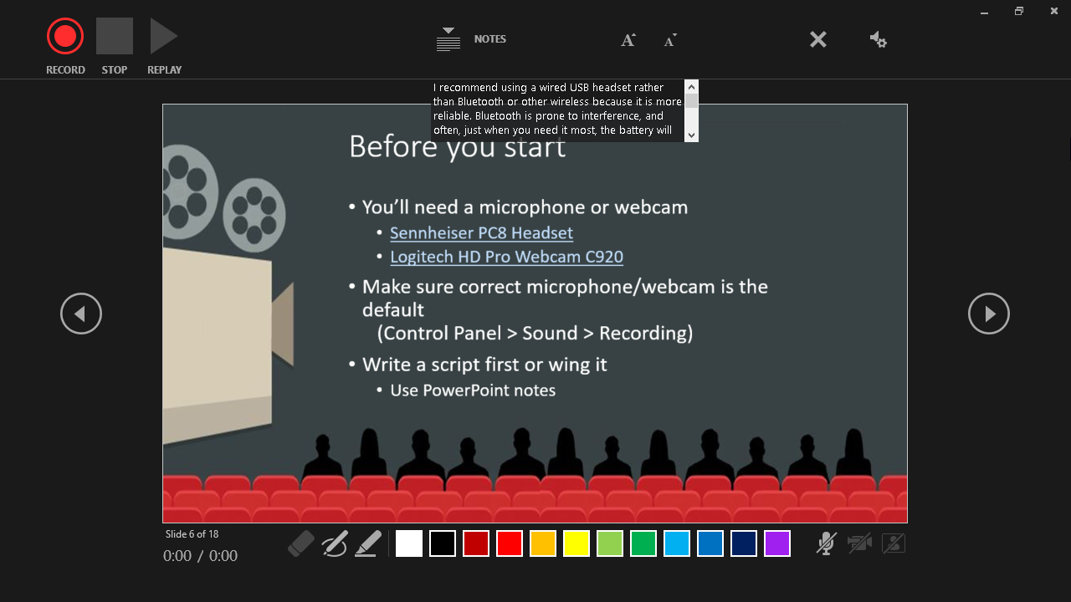
PowerPoint 365 Screenshot

Slide 10
Recording Tips
Don't speak while advancing the slide
Include brief silence at the beginning and the end of each slide to make the transitions smooth and ensure that you don't cut off audible narration
Before you get too far down the road of recording your presentation, make sure your audio and video sound and look the way you expect.

Slide 11
Embed videos into Canvas

Slide 12
3C Media Resources
3C Media App for Canvas Instructions
3CMediaSolutions.org Website
3C Media Guides

Slide 13
3C Media Canvas App
Like YouTube, but for California Community Colleges
Free video posting and captioning
Can be used to live stream your lectures/events
In Canvas enable the 3C Media menu link in
Settings > Navigation tab

Slide 14

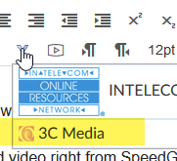
Embedding 3C Media in Canvas
In Canvas, Add a page to a module, then Edit the page and click where you want to embed the video.
Click the V icon
and select 3C Media

Slide 15
Tips
Keep it Concise: 5-10 minute clips work best
Scaffold: Tell students how to use the video. (e.g. "Watch this for examples of drawing techniques.")
Include learning activities. Watching video tends to be passive, so follow up with something to get students active. You could also embed the video with "pause and practice" instructions.
Allow imperfection. Don't worry too much about little mistakes.

