Slide 1

Facilitating Group Work on Zoom
Rachel Polakoski · Cuyamaca College Math Department Faculty Rachel.Polakoski@gcccd.edu

Slide 2
Tell me about you!
Do you use group work in your face-to-face instruction?
Have you used breakout groups on Zoom before?
Have you used Zoom polling?

Slide 3
Get to Know the New Classroom
How are students accessing zoom?
Do they have a camera?
Do they have a microphone?
What’s their environment like? Free of distractions? Loved ones to care for? Others competing for internet bandwidth?

Slide 4
Get Students Talking
Start class with a conversation starter
  What are you binge watching?
  What’s one good thing that has come from staying at home?
  What do you do to help you destress?
Call on each student to share via microphone or chat.
20 Questions to ask instead of how are you doing right now.

Slide 5
Low-Stakes Collaborative Practice
Less lecture and more student engagement through the use of…
  Zoom Breakout Groups
  Zoom Polling
  Canvas Discussion Boards

Slide 6

Zoom Breakout Groups
Take group work that would happen in class and put students into groups on Zoom!
Randomly assign groups or choose them.
Teacher can “pop” into groups - accountability!
Students can request help in groups
Teacher can broadcast a message to all groups
Tips For Success
Do a practice group session with something low-stakes
Make sure all students have a handout to look at while in groups
Encourage (but do not require) videos on
Set new norms - ambassador from each group to report out when we return
Pause recording during group work

Slide 7



Think-Pair-Share
Post a prompt in the general session and allow students a few minutes to think about it and jot down ideas.
Pair up students into breakout rooms to compare thoughts
Return to general session and share out

Slide 8




Ambassador Exchange
Send students into breakout groups of 3-4. All students are working on the same prompt.
After a few minutes of group discussions, shuffle one member of each group to another group. The ambassador will share their thoughts with the new group and vice versa.
Return the ambassador to their home group for one last check on ideas and to share anything learned from the ambassador exchange.

Slide 9
Jigsaw
Send students into breakout groups of 3-4. All groups are working on different prompts. Tell students that everyone in the group needs to get good enough at their prompt to teach someone else.
After groups show mastery, regroup so a representative for each prompt is present in each group. Students take turns teaching each other what they learned.

Slide 10
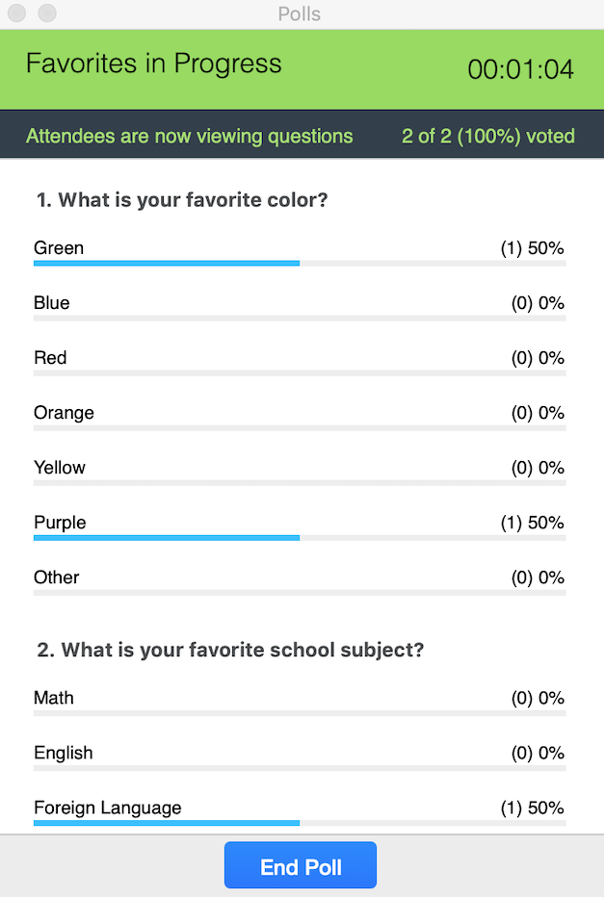
Zoom Polling
Anonymous - but teacher can download results
Teacher can publish poll results for students to see
Great way to keep students actively engaged during a lecture
Could be used to collect data that students later analyze!
Tips For Success
Set your polls up before the meeting begins
In a pinch, have students type responses into chat in Zoom.

Slide 11
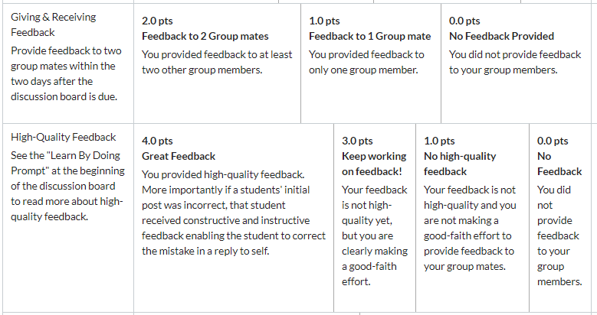
Canvas Discussion Boards
Can require students to post before seeing others replies
Allows students to comment and reply to each other
Teacher can use Canvas speedgrader to easily grade and provide individual feedback
Tips For Success
Set clear expectations for student-to-student interaction - consider a grading rubric
Break the class up into smaller groups using Canvas Groups
Don’t allow students to edit posts. Instead ask them to reply to self with corrections

Slide 12
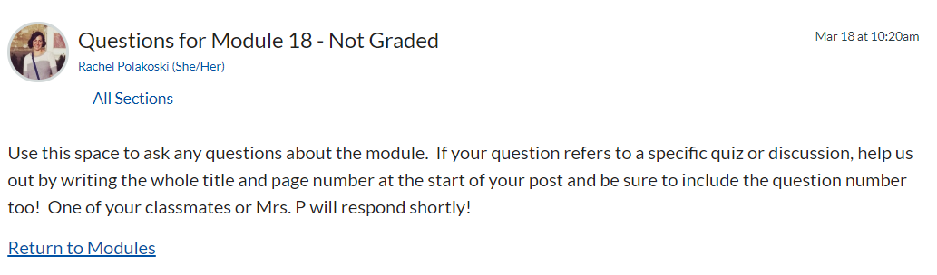
More on Discussion Boards
Use discussion boards to create a place for students to post questions they have from class or on homework
Students can help each other!
Cuts down on emails to teacher
Tips For Success
Takes some training for students - when they email you, encourage them to post that question in the appropriate discussion board.

Slide 13
Questions?
Rachel Polakoski · Cuyamaca College Math Department Faculty · Rachel.Polakoski@gcccd.edu

Slide 14
Resources
Zoom How-To’s
  Using Polls during your class.
  Using breakout rooms during your class.
Canvas How-To’s
  Create groups in discussion boards.

