Slide 1
Equitable Teaching (During a Pandemic)
Teaching Dialogues
Friday, April 10, 2020
Raquel Jacob-Almeida

Slide 2
Changes in Response to EMTLI
Value & incorporate students’ experiences and expertise
Media Analysis Assignments (Intro; Race & Ethnicity)
Course Projects (Social Problems; Gender & Sexuality)
Students choose their topic
  Select journal article, news article, media (with guidance)
Workshops (computer lab) & HW’s “build” their projects over semester
No more exams (and I love it)
Ch. HWs guide reading & check comprehension
In-class “extra credit” quizzes (score added to ch. hw’s)

Slide 3
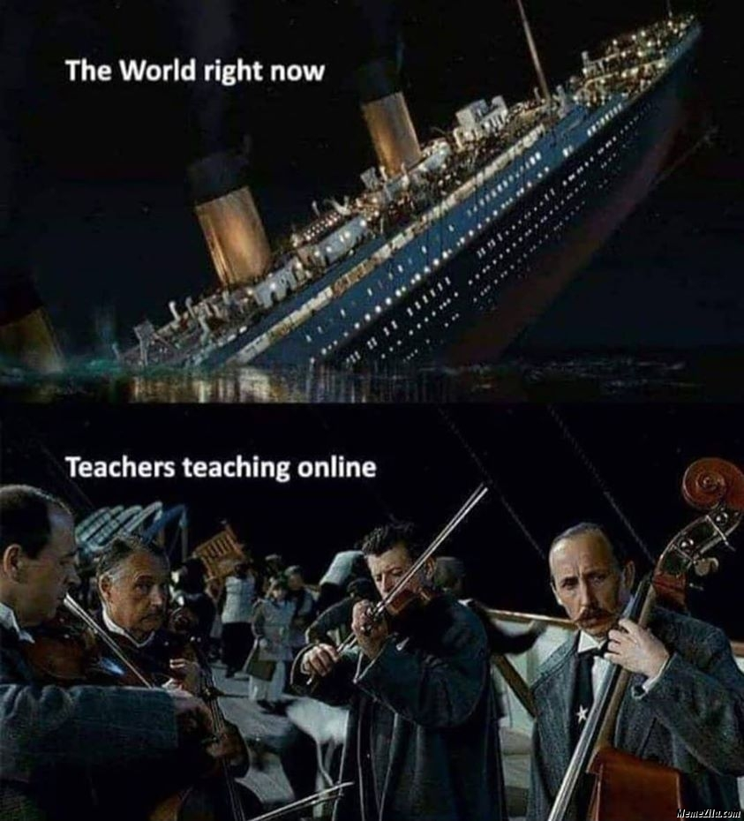
Transition to Remote Learning

Slide 4
Transition to Remote Learning
Recognize that “this is triage”
limited computer, data, internet access; houseless; full houses; limited workspace; no child care including homeschooling; domestic abuse; “essential” workers; direct contact with coronavirus; job loss; immigration status (no access to $ relief); family members with coronavirus; anxieties/depression; dislike/unfamiliarity with online learning; limited student services, etc…
Ethic of care, empathy, well-being (incl Cuyamaca College)
What is your (my) central objective?

Slide 5
Transition to Remote Learning
Scaled back assignments: shorter and fewer
Cancelled Projects =(
Assignments: discussions, apply course material to own topic or pandemic
Communication, flexibility, don’t penalize students (ex: for not completing)
Class time on Zoom
  Synchronous, recorded, posted on Canvas
  Lectures are shorter (30 minutes max)
    Zoom exhaustion; more difficult to concentrate; less interactive
  Gender & Sexuality: entirely discussion of assigned reading (recorded)
  Do not require students to show personal lives (video is optional)

